Slide 1
Week 5
SQL – INSERTING, UPDATING AND DELETING ROWS OF DATA

Slide 2
Student Objectives
Upon completion of this video, you should be able to:
Insert rows of data into a table
Update a row(s) of data in a table or some attributes within rows in a table
Delete a row of data from a table
Show the attribute names and types for an existing table

Slide 3
INSERTING Data Into Tables:
INSERT INTO TableName (Attr1Name, Attr2Name, Attr3Name) VALUES (value1, value2, value3);
OR
INSERT INTO TableName VALUES (value1, value2, value3);
NOTE: if you use this method you must put a value for EVERY field and in the correct order that the fields are in the table
Example:
INSERT INTO owner (firstname, lastname, ownerid) VALUES ("Laura","Reid",1);

Slide 4
UPDATING Existing Data:
UPDATE TableName SET AttrName = 'Value' WHERE Condition;
Example:
UPDATE owner SET firstname=“Elaine” WHERE firstname =“Laura”;

Slide 5
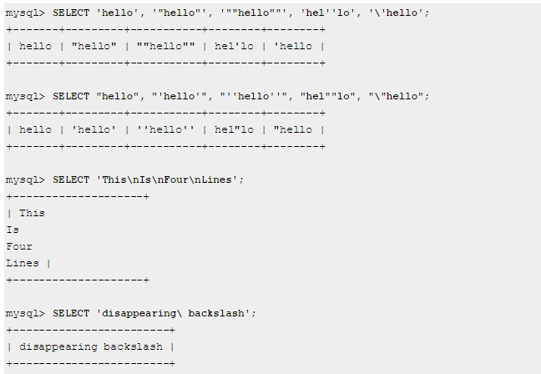
Examples using Quotes:

Slide 6
DELETING Tuples From Tables:
DELETE FROM TableName WHERE Condition
Example:
DELETE FROM owner WHERE lastname =‘Reid‘;

Slide 7
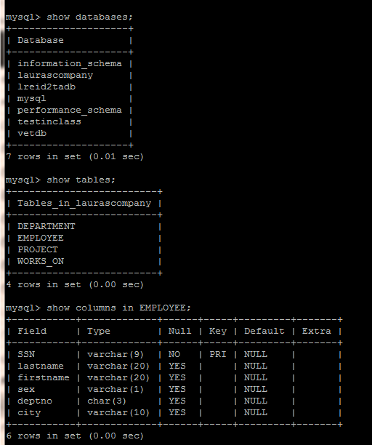
Getting information back (if you can’t remember table names or column names)
SHOW DATABASES;
SHOW TABLES;
SHOW COLUMNS IN tablename;
e.g. SHOW COLUMNS IN employee;

